Slide 1
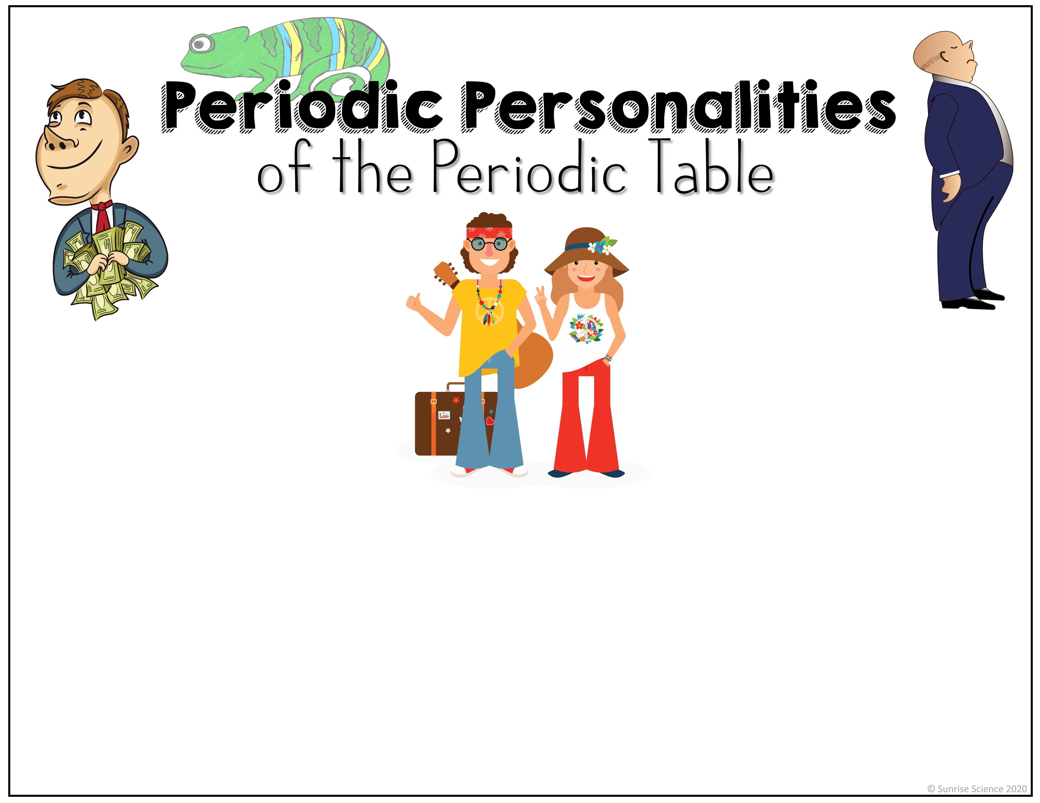
The Periodic Table is filled with patterns and trends! The elements that make up the various ‘element families’ behave similarly because of the similarities in their atomic structures.
We can use analogies to help us remember the way some of the elements behave in chemical reactions.

Slide 2

Alkali Metals and Alkaline Earth Metals
The Alkali Metals (group 1) and the Alkaline Earth Metals (group 2) are highly reactive, relatively soft metals. They give away their valence electrons to other atoms. They can be thought of as the ‘hippies’ because they’d rather ‘live’ with less.

Slide 3
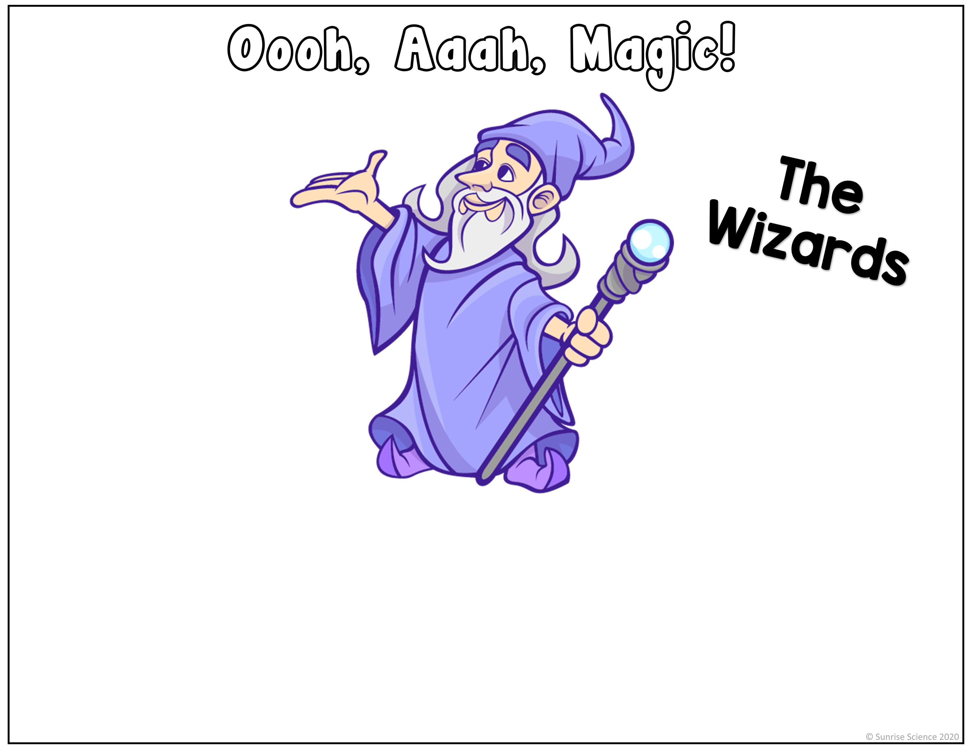
Transition Metals
The Transition Metals (groups 3 through 12, except #’s 71 & 103) are good conductors, they are strong, and they have high melting and boiling points, so they are used a lot in industry. Many of them form colorful compounds (fireworks!). Gold & Copper are special colors, and Mercury is a liquid at room temperature. These are the ‘wizards’.

Slide 4
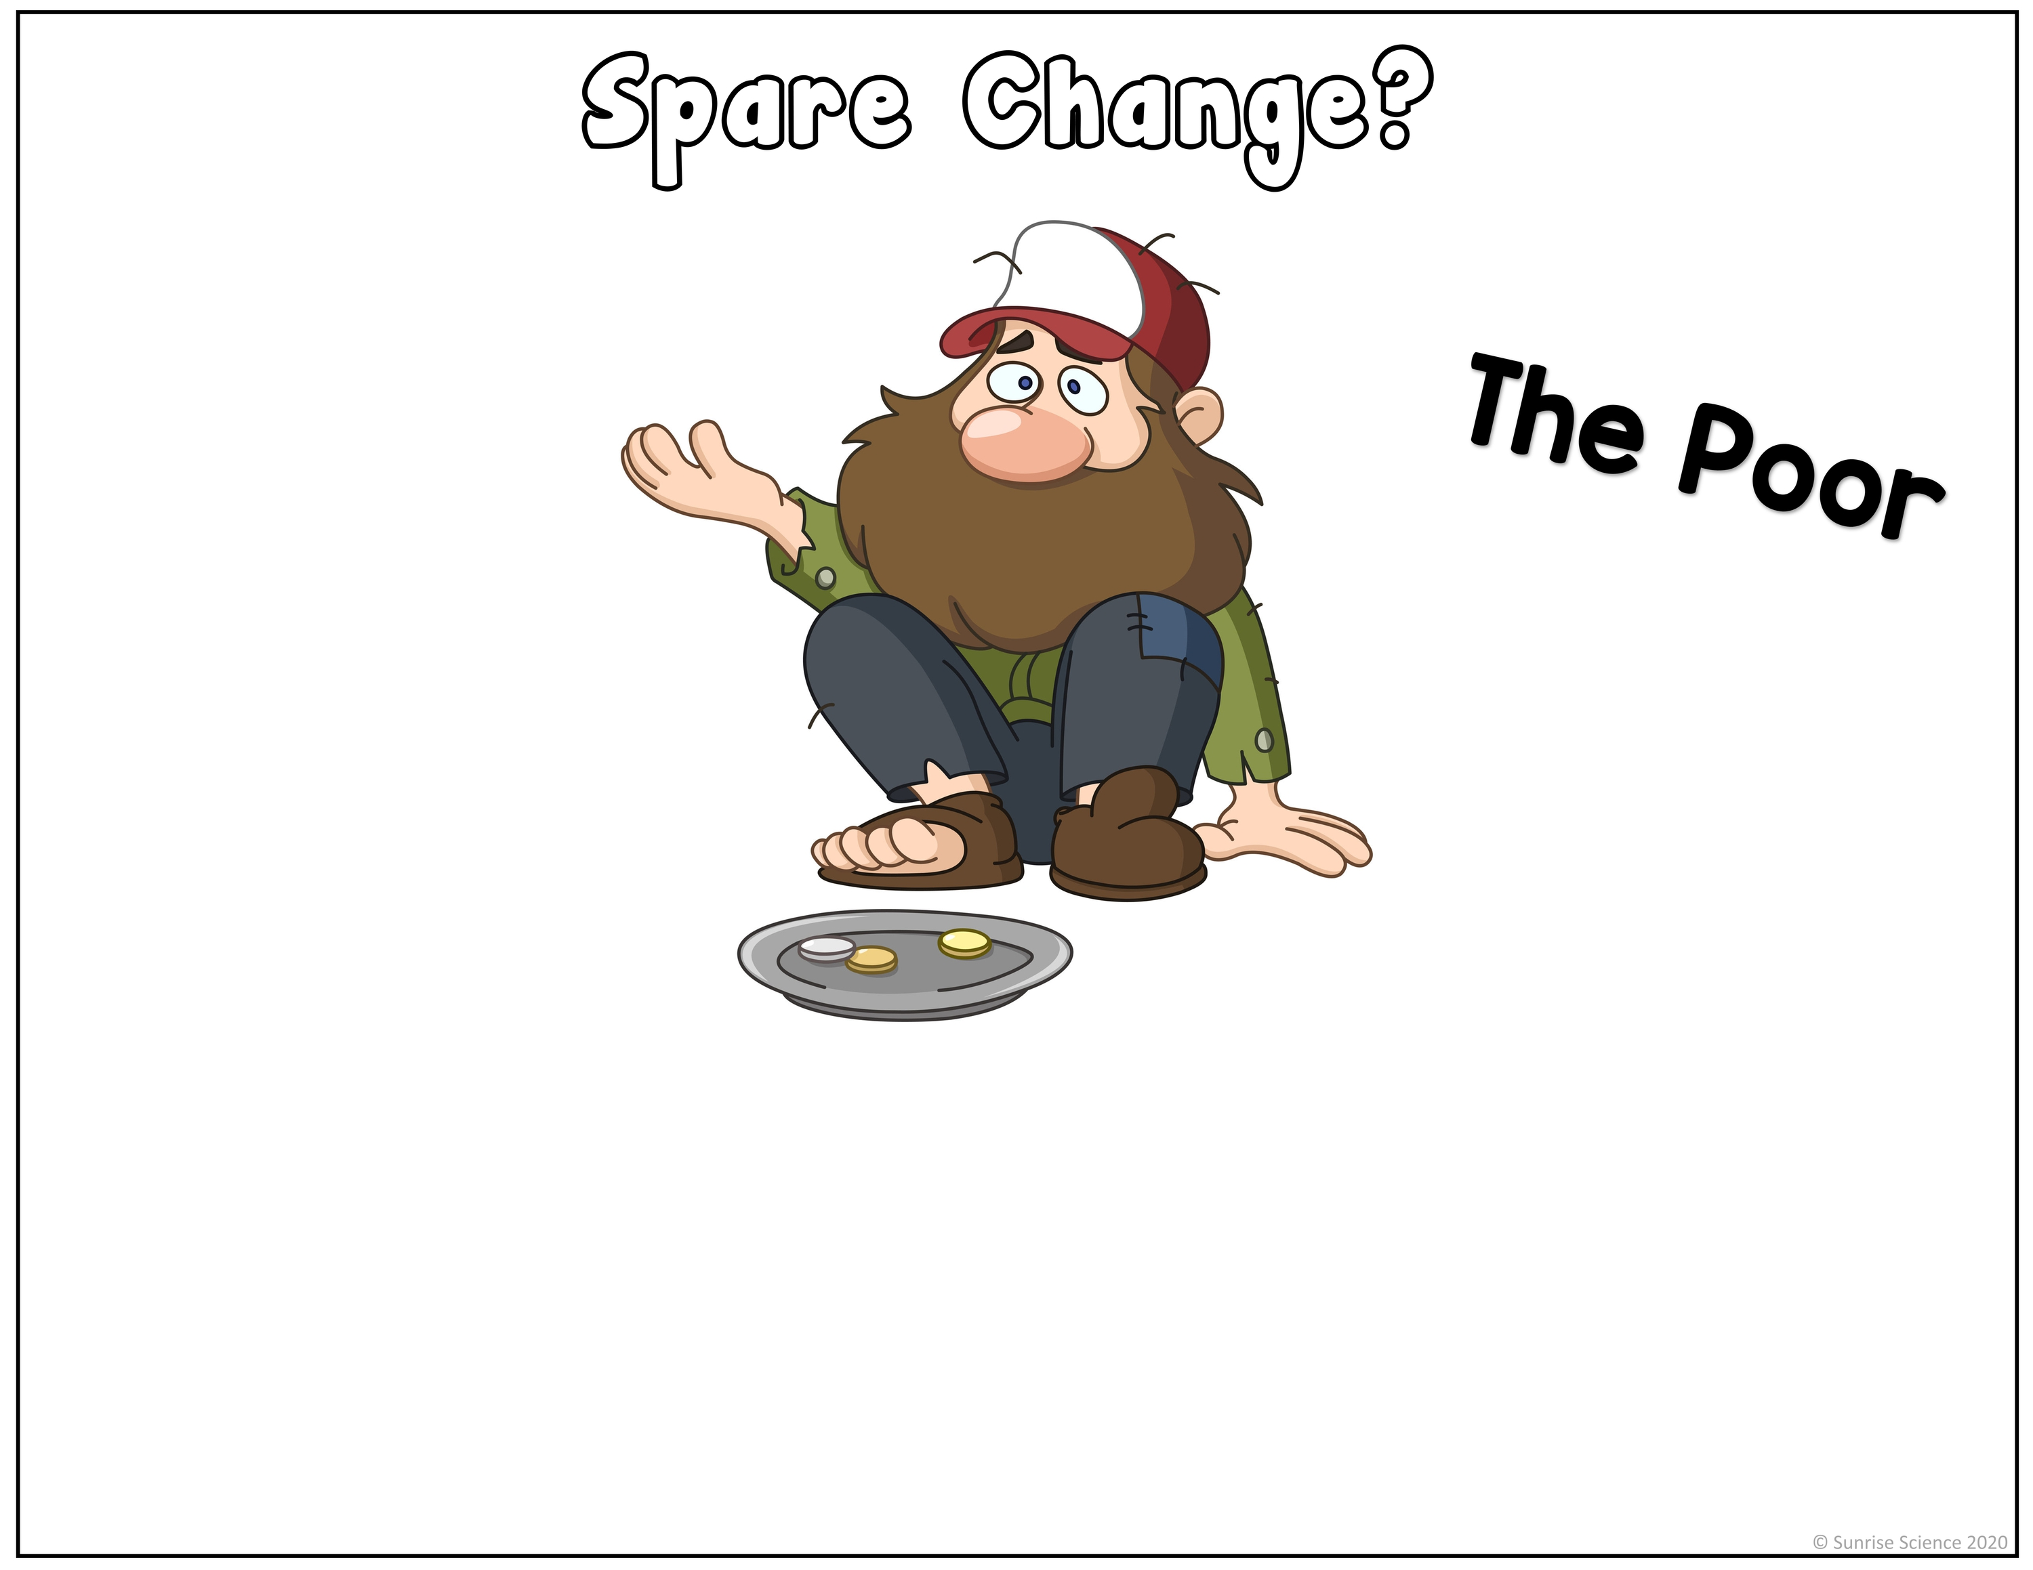
Poor Metals
(also called the Other Metals or the Post Transition Metals)
The Poor Metals (the elements under the ‘staircase’) are soft metals and they have poor mechanical strength (malleability, ductility, etc.). They have lower melting and boiling points than the transition metals, but they have higher electronegativity (the tendency to grab electrons from other atoms). These elements can be thought of as the ‘poor’.

Slide 5

Metalloids
The elements Boron, Silicon, Germanium, Arsenic, Antimony, Tellurium, and Polonium sit on the line between the metals and the nonmetals. Known as the Metalloids, they tend to look like metals and behave like nonmetals, so they can be thought of as the ‘chameleons’.

Slide 6
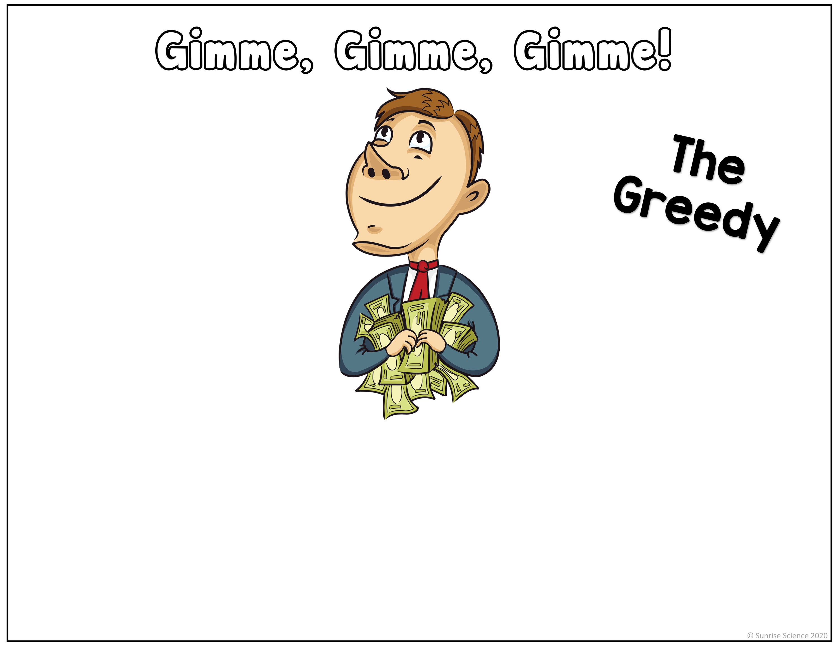
Oxygen Group and Halogens
The Halogens (group 17) and the non-metals of the Oxygen Group (group 16) can be thought of as the ‘greedy’ guys because they snatch the valence electrons from other atoms (from the metals).

Slide 7

Noble Gases
The Noble Gases (group 18) are unreactive with the other types of atoms on the periodic table because they have everything they need (a full valence electron shell). These gases can be thought of as the ‘snobs’.

Slide 8
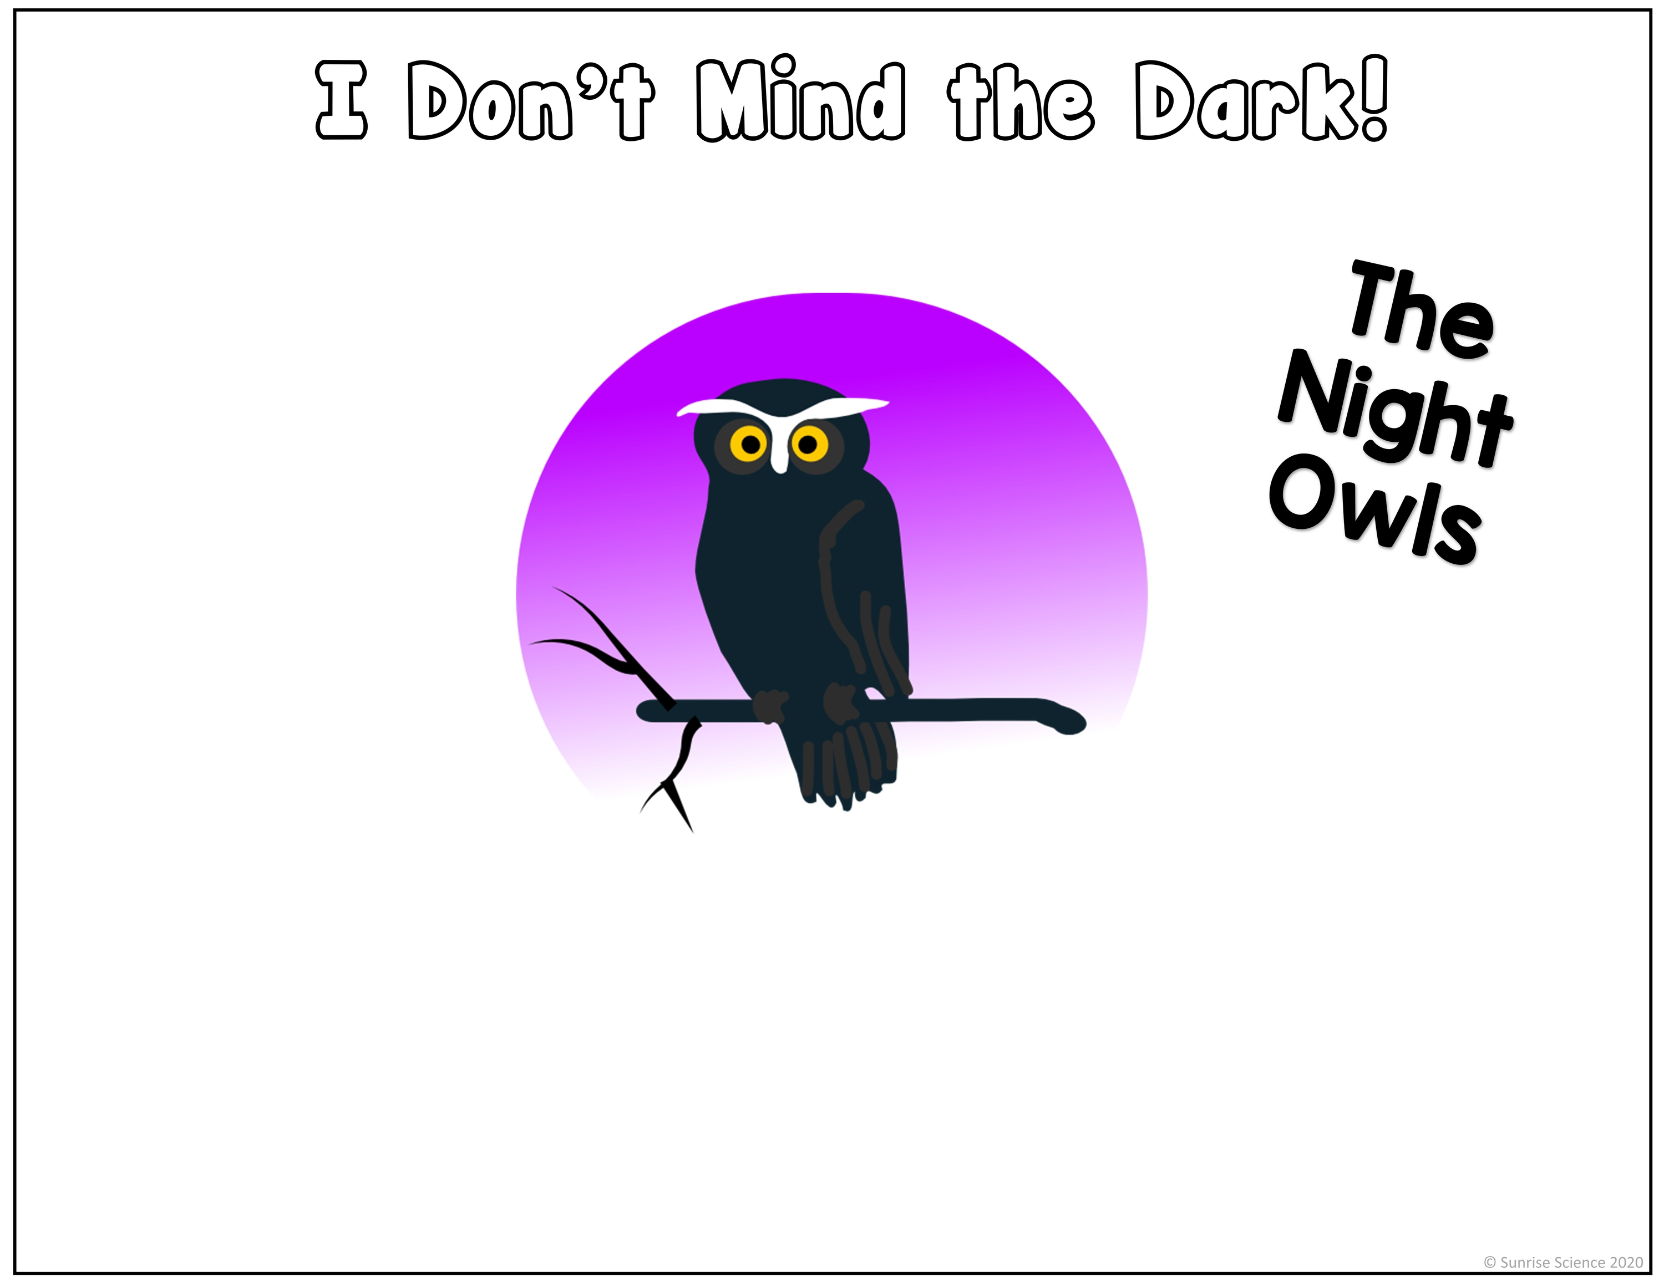
Lanthanides
The metals of the Lanthanide Series (elements 57-71) are used for lasers, lamps, lighters, fluorescence, and X-raying, so they are like the ‘night owls’.

Slide 9

Actinides
The metals of the Actinide Series (elements 89-103) are all very large, unstable, and radioactive atoms. They can be thought of as the ‘monsters’.

